Slide 1
3D Solar System Simulation for Efficient Interplanetary Travel Routes
Spoiler: It is harder than I imagined

Slide 2

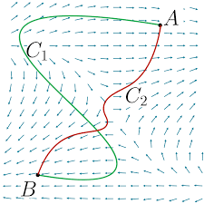
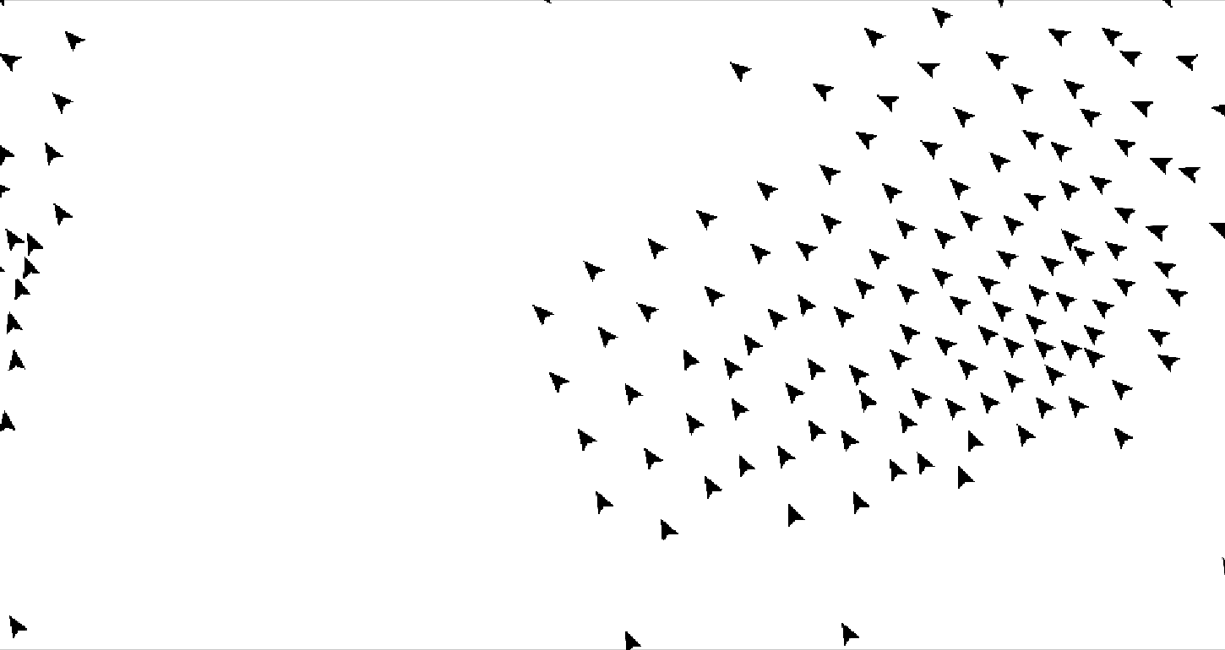
Introduction:
This Project aims at modelling the solar system in 3d space, with information such as Position of Planets at any given point in time, and the value of the total gravitational potential energy as well as the Total gravitational force at any point in space time.
The objective of the Project is to use the model, along with heuristic path finding algorithms to compute the most efficient path for a spacecraft from one point in space time to another.

Slide 3
Research Questions
What is the most fuel and time-efficient path from Earth to Mars?
This question forms the core of the project and focuses on developing an algorithm that minimises both fuel consumption and travel time for an Earth-Mars journey.
Can this path-finding algorithm be generalised for any destination in the solar system? If yes, what will this algorithm be?
This question investigates the potential for the developed algorithm to be applied to routes beyond Earth and Mars, examining its versatility within the solar system. In the event that the algorithm can be generalised, this question seeks to identify the specific characteristics and parameters of the algorithm that would enable its application to other destinations in the solar system.
Will it work for any other system?
This broader question explores the possibility of extending the algorithm's applicability to celestial systems beyond our solar system, assessing the potential for adaptation and generalisation.

Slide 4
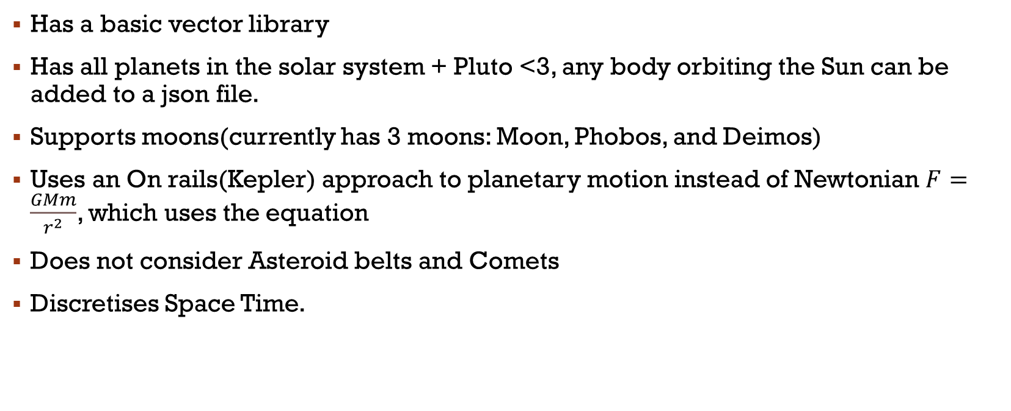
Model:
Has a basic vector library
Has all planets in the solar system + Pluto <3, any body orbiting the Sun can be added to a json file.
Supports moons(currently has 3 moons: Moon, Phobos, and Deimos)
Uses an On rails(Kepler) approach to planetary motion instead of Newtonian $F=\frac{GMm}{r^{2}}$, which uses the equation
Does not consider Asteroid belts and Comets
Discretises Space Time.

Slide 5
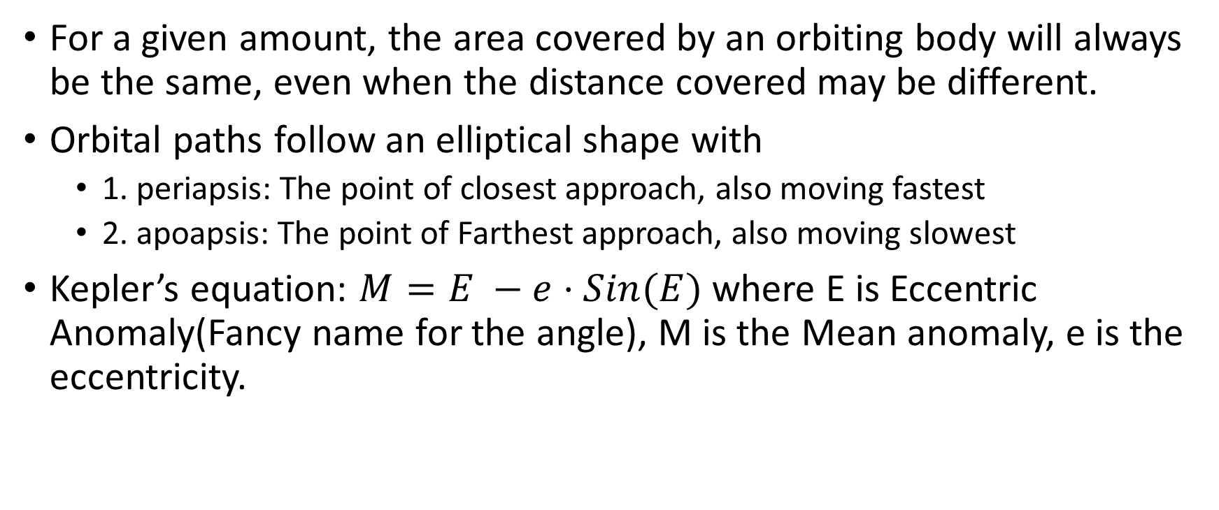
Kepler’s Principle
For a given amount, the area covered by an orbiting body will always be the same, even when the distance covered may be different.
Orbital paths follow an elliptical shape with
1. periapsis: The point of closest approach, also moving fastest
2. apoapsis: The point of Farthest approach, also moving slowest
Kepler’s equation: $M=E −e⋅Sin(E)$ where E is Eccentric Anomaly(Fancy name for the angle), M is the Mean anomaly, e is the eccentricity.

Slide 6


Kepler – The ellipse

Slide 7

Kepler- The ellipse Returns

Slide 8
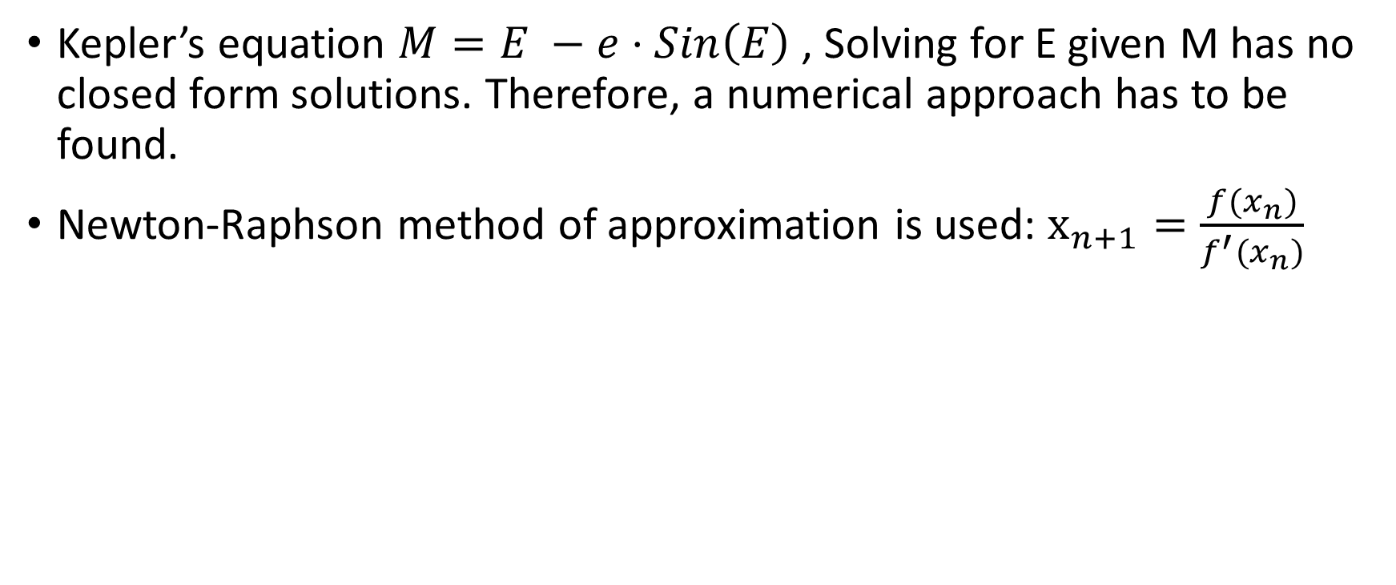
Kepler 2- The equation
Kepler’s equation $M=E −e⋅Sin\left(E\right)$, Solving for E given M has no closed form solutions. Therefore, a numerical approach has to be found.
Newton-Raphson method of approximation is used: $x_{n+1}=\frac{f(x_{n})}{f^{′}(x_{n})}$

Slide 9
Kepler 2.5 – The Solver:
def SolveKepler(M, e):
Kepler_Equation = lambda M, E, e: E-(e*np.sin(E))-M
kepler_Equation_Differentiated = lambda E,e : 1-e*np.cos(E)
accuracy : float = 1e-10
Maxiteration : int = 100
E : float = e if e <= 0.8 else np.pi
for i in range(0, Maxiteration):
nextvalue = E-(Kepler_Equation(M,E,e)/kepler_Equation_Differentiated(E,e))
difference = np.abs(E - nextvalue)
E = nextvalue
if(difference < accuracy): break
return E

Slide 10
Kepler 3- The finale
def ComputePointOrbit(Apoapsis, Periapsis, theta, inclination):
semiMajor = (Apoapsis + Periapsis)/2.0
semiMinor = (Apoapsis*Periapsis)**0.5
meanAnomaly = theta % 2*np.pi
linearEccentricity = semiMajor - Periapsis
eccentricity = linearEccentricity/semiMajor
eccentricAnomaly = SolveKepler(meanAnomaly, eccentricity)
x = semiMajor * (np.cos(eccentricAnomaly) - eccentricity)
y = semiMinor * np.sin(eccentricAnomaly)
inclinedPlane = rot.from_euler('y',inclination, True)
result = inclinedPlane.apply([x,y,0])
return vector(result[0], result[1], result[2])

Slide 11
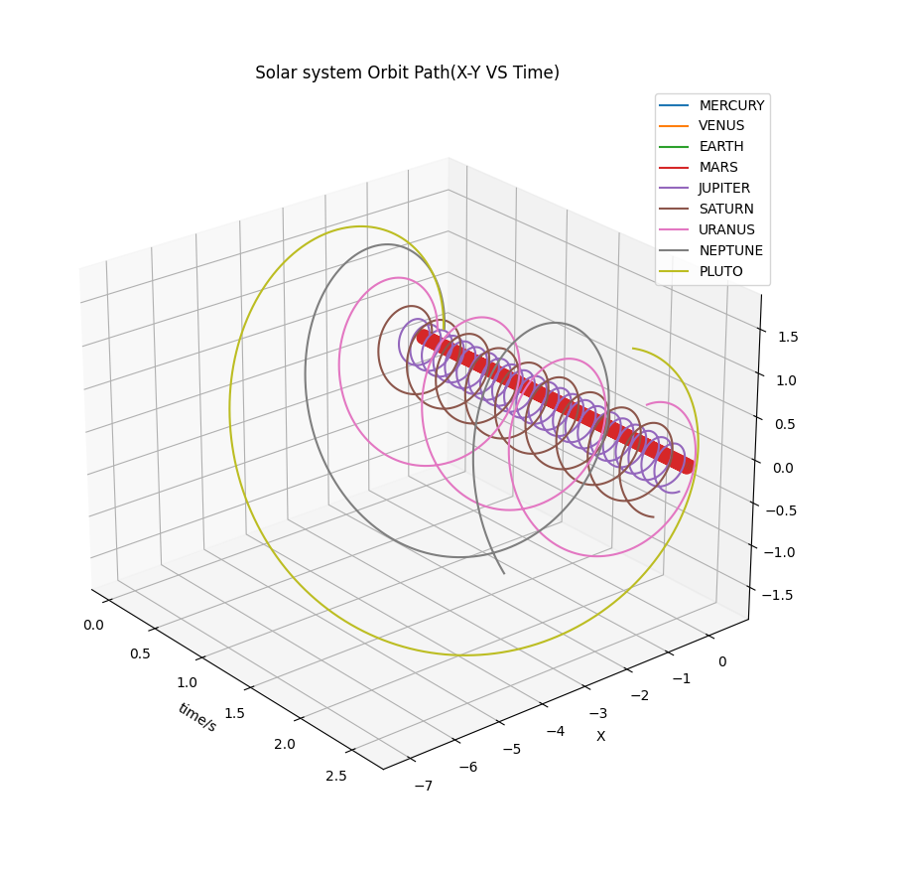
Plots!
fig = plt.figure()
ax = plt.axes(111,projection = '3d')
for i in range(0, len(RawPlanetData)):
ax.plot(t,PlanetPositionsX[i], PlanetPositionsY[i])
ax.set_xlabel("time/s")
ax.set_ylabel("X")
#ax.set_zlabel("Y")
ax.legend([p.planet for p in RawPlanetData], loc = 'upper right')
plt.title(" Solar system Orbit Path(X-Y VS Time) ")

Slide 12
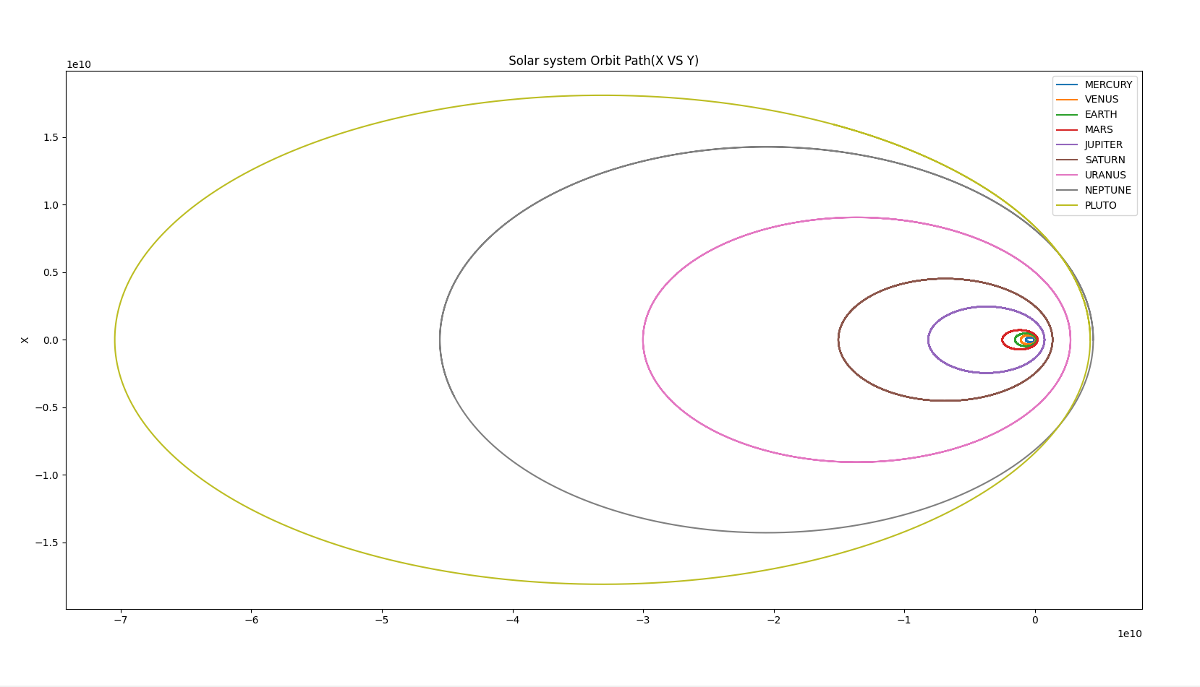

Slide 13
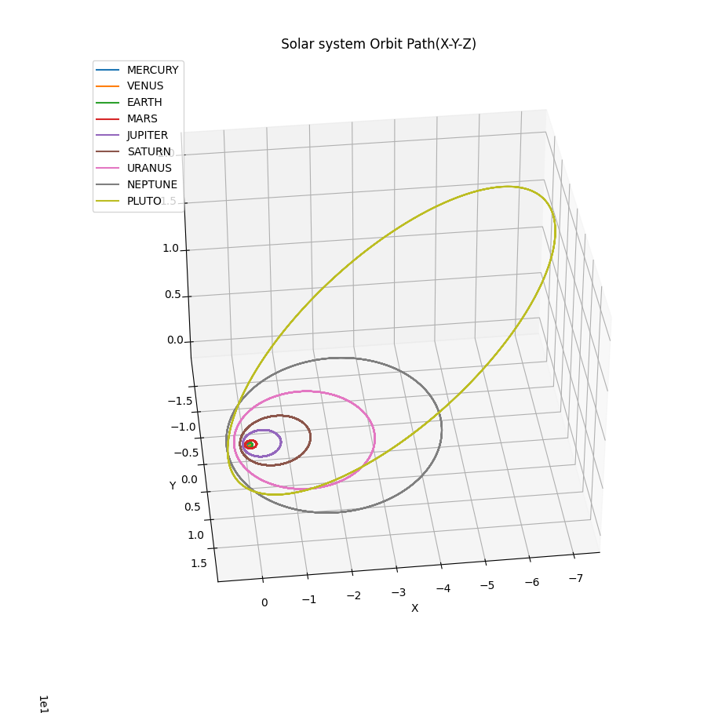

Slide 14
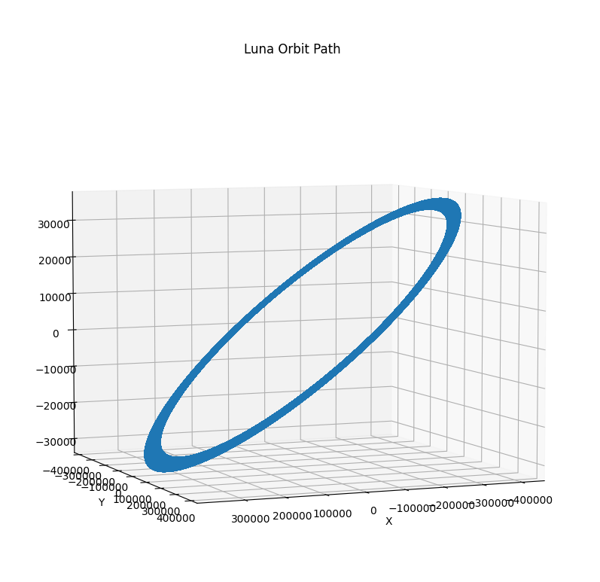
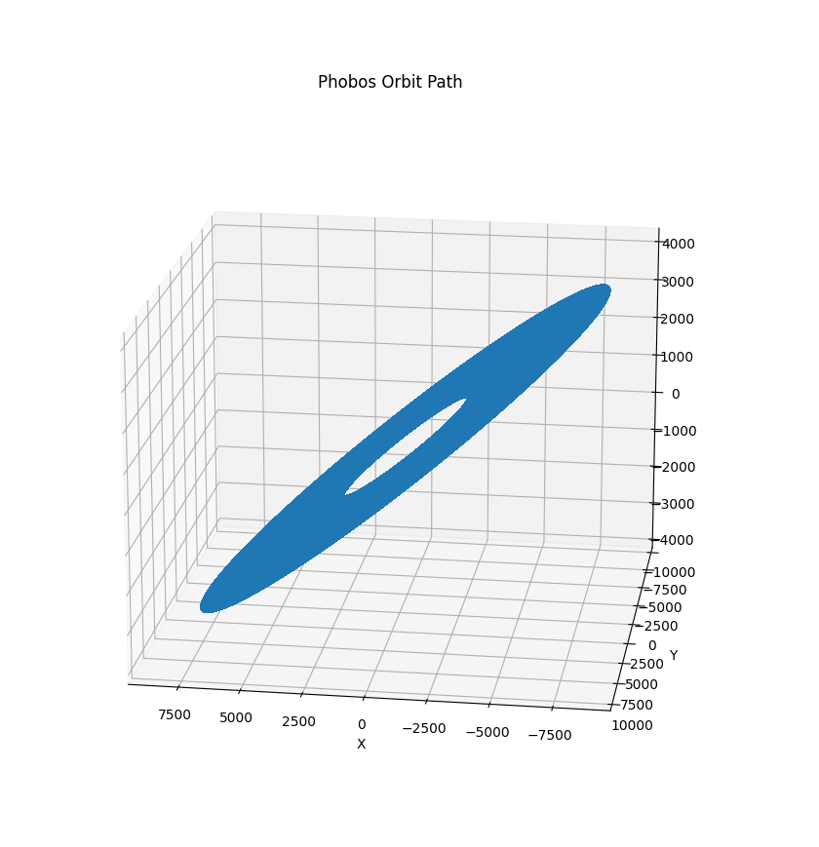
Moons

Slide 15
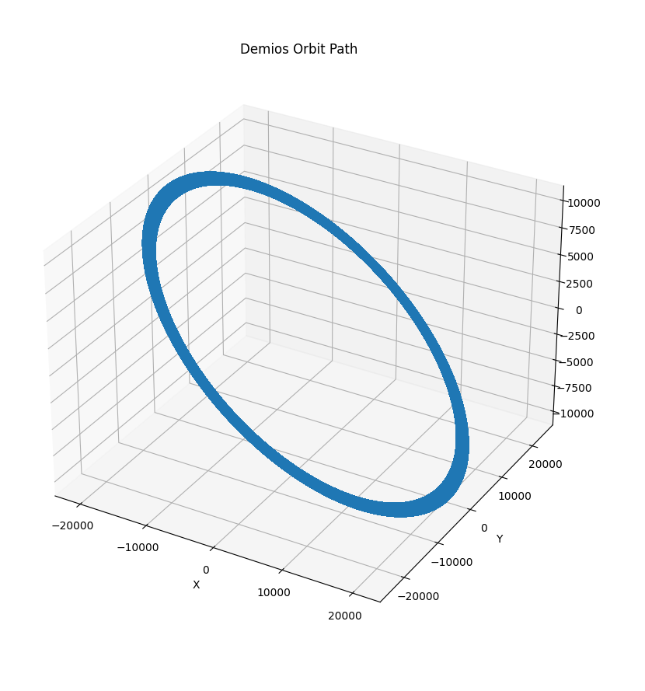
Also Moon

Slide 16
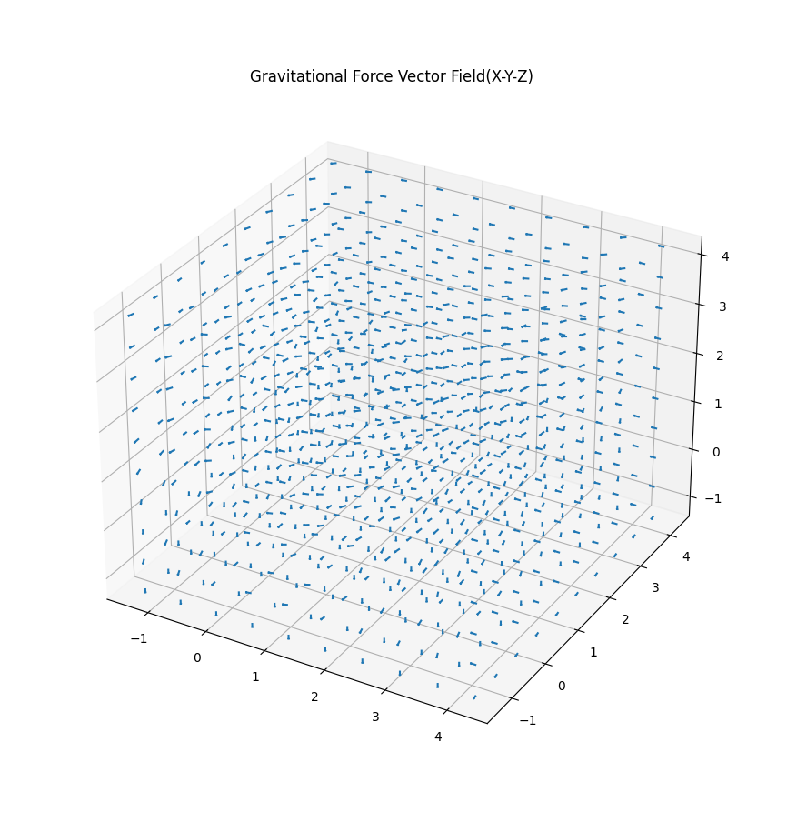

Slide 17
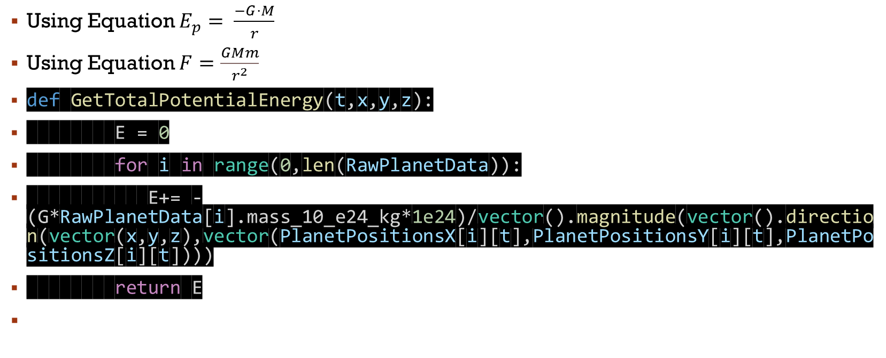
Potential and Gravitational Forces
Using Equation $E_{p}= \frac{−G⋅M}{r}$
Using Equation $F=\frac{GMm}{r^{2}}$
def GetTotalPotentialEnergy(t,x,y,z):
E = 0
for i in range(0,len(RawPlanetData)):
E+= -(G*RawPlanetData[i].mass_10_e24_kg*1e24)/vector().magnitude(vector().direction(vector(x,y,z),vector(PlanetPositionsX[i][t],PlanetPositionsY[i][t],PlanetPositionsZ[i][t])))
return E

Slide 18
Cont.
def GetResultantGravitationalForce(t,x,y,z):
F = vector()
for i in range(0,len(RawPlanetData)):
F.x+= -(G*RawPlanetData[i].mass_10_e24_kg*1e24)/vector().magnitude(vector().direction(vector(x=x),vector(x = PlanetPositionsX[i][t])))**2
F.y+= -(G*RawPlanetData[i].mass_10_e24_kg*1e24)/vector().magnitude(vector().direction(vector(y=y),vector(y = PlanetPositionsY[i][t])))**2
F.z+= -(G*RawPlanetData[i].mass_10_e24_kg*1e24)/vector().magnitude(vector().direction(vector(z=z),vector(z = PlanetPositionsZ[i][t])))**2
return F

Slide 19
Space Travel bit?
Computing power is limited: Turns out computing the paths using flock swarm or vector field algorithms is very computationally demanding at this scale. Optimization is definitely possible but given the time, and my current capacity, I could not figure it out on time ☹.

Slide 20
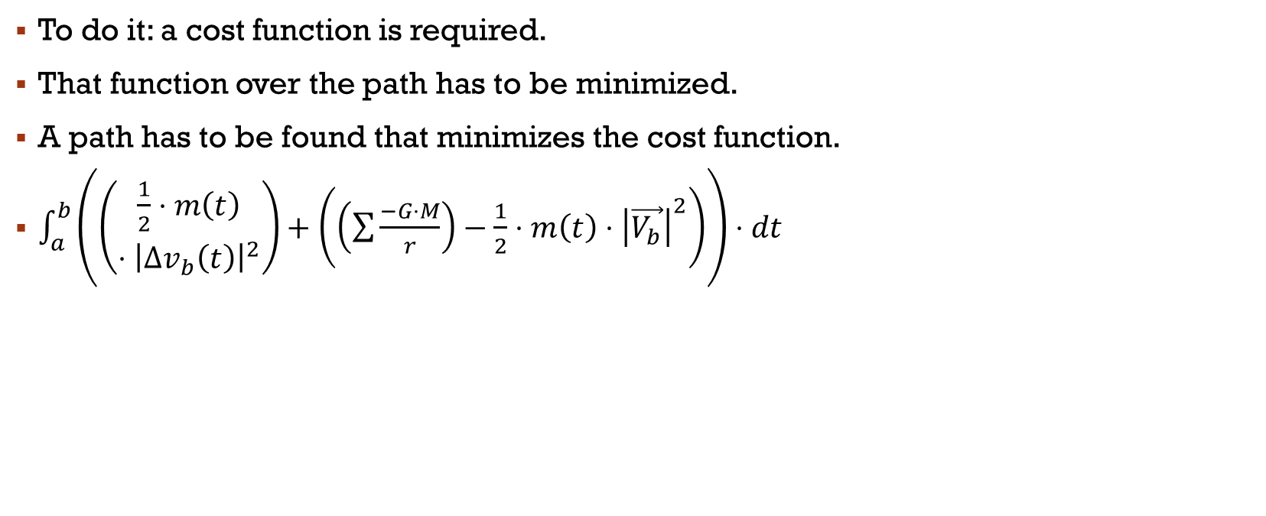
But:
To do it: a cost function is required.
That function over the path has to be minimized.
A path has to be found that minimizes the cost function.
$\int_{a}^{b}{\left(\left(\begin{aligned}\frac{1}{2}⋅m\left(t\right) \\ ⋅{\left|Δv_{b}\left(t\right)\right|}^{2}\end{aligned}\right)+\left(\left(\sum{\frac{−G⋅M}{r}}\right)−\frac{1}{2}⋅m\left(t\right)⋅{\left|\vec{V_{b}}\right|}^{2}\right)\right)⋅dt }$

Slide 21
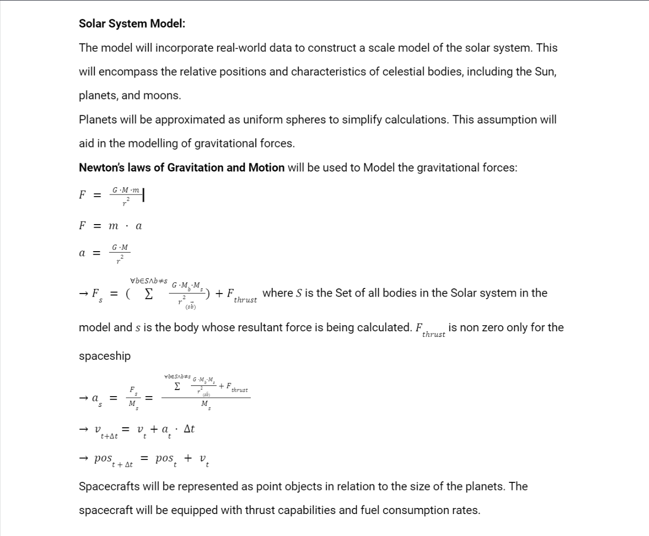
Cont.

Slide 22
References
Williams, Dr. D. R. (2023, February 11). Planetary fact sheet. NASA. https://nssdc.gsfc.nasa.gov/planetary/factsheet/
NASA. (n.d.). Navigation - NASA Science. NASA. https://science.nasa.gov/learn/basics-of-space-flight/chapter13-1/
Ben Amarat, S. and Zong, P. (2019), "3D path planning, routing algorithms and routing protocols for unmanned air vehicles: a review", Aircraft Engineering and Aerospace Technology, Vol. 91 No. 9, pp. 1245-1255. https://doi.org/10.1108/AEAT-01-2019-0023
Halley, E., Newton, I., Royal Society Associated Name & Streater, J. (1687) Principia. London: Royal Society.
Kepler, Johannes, 1571-1630. Astronomie Nouvelle = Astronomia Nova. Paris :A. Blanchard, 1979. APA. Kepler, Johannes, 1571-1630. (1979).
Lagrange, J. L. Mécanique Analytique . Paris, Ve Courcier, -15, 1811.
https://opensource.gsfc.nasa.gov/projects/emtg/index.php

